Slide 1
Cascading Style Sheets
04
I399 Web Development

Slide 2
Comparing HTML & CSS
HTML
Describes the content and content hierarchy
Elements are made of tags and attributes
File extension is .html
CSS
Describes the format and positioning
Style rules are made of selectors and declarations
File extension is .css

Slide 3
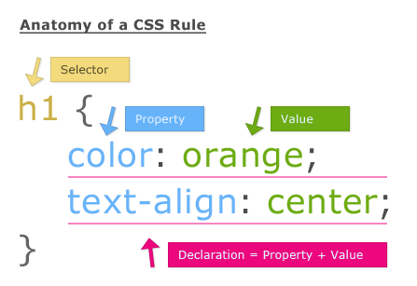

Slide 4
First: Choose your content, replace special characters, markup HTML (Our goal from Project 1)
Writing good CSS starts with identifying the HTML tags (with the content contained between them) that you want to modify/style THEN styling using CSS Selectors.
<h1>, <p>, <body>, and so on..

Slide 5

HTML tags are hooks that you can use to style web page content.

Slide 6
Second: style the content with a Cascading Style Sheet (CSS).
CSS creates a set of rules for how your HTML content should look and behave.
For example, you might have a rule that says, all paragraphs that are part of a group called "alert" should be red, bold and centered.
Or all <h2>s should be in Gil Sans font and have a space before and after they appear.

Slide 7
Applying a style: the basics:
Identify an HTML tag, HTML attribute, a CSS selector and CSS declaration:
…
<head>
<link …href=”styles.css”>
</head>
<body>
<h1>Save Reuben!</h1>
<p class=”intro”>
Minecraft pigs are pigs too!
</p>
</body>
...
link the two files together - FYI if the <link> is not working, none of your styles will show up.
…
h1 {
color: red;
}
...
.intro {
font-size: 18px;
}
reference the
HTML tag to style
or style based on class or id
page.html
styles.css

Slide 8
Figuring how to style your HTML content can be tricky sometimes...
How would you style… (general)
the bullet points for all lists?
paragraphs?
How would you style… (specific)
the byline in an article?
the image you want centered when the rest are left aligned?
Or even trickier… (even more specific)
placing a drop cap only on the first paragraph?
styling every other image on a page?
make the third line of the third paragraph blue?

Slide 9
CSS Selectors
The most basic selector is by HTML tag name:
HTML <h3>Restaurants in Beijing</h3>
CSS h3 { ... }

Slide 10
CSS Selectors
We can give items special or unique names…
HTML: class=“class-name” CSS: .class-name { }
HTML: id=“id-name” CSS: #id-name { }
Or we can go a level deeper with our selection...
ul li For example… will only select list items that are part of an unordered list, not an ordered list

Slide 11
CSS Selectors
List selectors in order to apply general styling rules to a group of elements:
h1, h2, h3, p, ul, li {
font-family: 'Garamond Pro', Georgia, serif; }
This is the same as writing each CSS selector individually:
h1 { font-family: 'Garamond Pro', Georgia, serif; }
h2 { font-family: 'Garamond Pro', Georgia, serif; }
etc..

Slide 12
The CASCADING feature of “CSS” comes in handy...
We first set general style rules for all elements of a certain type.
Then we add rules for specific HTML elements
Finally we have rules that apply to a smaller pieces of content, a specific element or place in a page, or are exceptions to the general style rules.
GENERAL -----> SPECIFIC -----> EXCEPTIONS

Slide 13
Specific rules should OVERWRITE general rules in order to make exceptions.
For example, what we want:
All <p> are set to be Times New Roman, 16px.
Any <p class=”captions”> should be Arial, 10px.
p {
font-family: ‘Times New Roman’, serif; font-size: 16px;
}
p.captions {
font-family: ‘Arial’, sans-serif; font-size: 10px;
}
Here the captions rule is BELOW the basic <p> rule, so captions will OVERWRITE the previously applied general paragaph style.

Slide 14
What do CSS selectors look like?
Element
p { color: blue; }
Class
.warning { color: red; }
p.warning { color: red; }
ID
#example { background-color: yellow; }
notice the dot
notice the hashtag

Slide 15
YOU TRY Write the CSS selector.
I want to style:
All <h1>
Any <p> with the class “alert”
A specific <div> with the id “container”
Try this out.. Make your guesses now.

Slide 16
YOU TRY Solutions.
All <h1> h1 { … }
Any <p> with the class “alert” .alert { … } OR p.alert { … }
A specific <div> with the id “container”
#container { … }

Slide 17
Whitespace and Comments
/* This is a CSS comment. */
/*
So is this.
*/
/************************************
And this...
************************************/

Slide 18
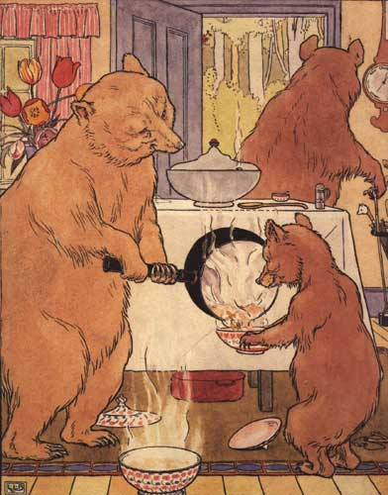
Goldilocks and the three methods for adding styles to your web page.
Website Fairy Tales

Slide 19
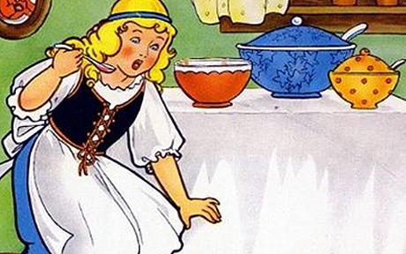
Inline styles are way too cumbersome!
<img src="porridge.jpg" style="width:400px; height:300px; border:0;">

Slide 20
Internal style sheets are too inflexible!
<head>
<style>
img { width : 400px; height : 300px;
border : 0; }
</style>
</head>

Slide 21
External style sheets are just right!
<head>
<link rel="stylesheet" type="text/css" href=“style.css">
</head>

Slide 22

Why go with external style sheets?
This means you could use ONE! ONE STYLESHEET for your
ENTIRE SITE.

Slide 23

OK, well, maybe it won’t be just ONE, but you COULD create a stylesheet for each group of related styles.
Collecting style rules together in this manner makes it easier to maintain
your website.

Slide 24

CSS and the Zen Garden
http://www.csszengarden.com

